Slide 1
Mutual of Omaha Individual Annuities
Annuity Portfolio and Certification Course

Slide 2
Annuity Overview
These are consumer’s main retirement objectives:
Maintain their current lifestyle at retirement, and
Provide for adequate health care

Slide 3
Annuity Overview
The importance of retirement planning has escalated in recent years due to concerns of:
Potential inadequacy of Social Security benefits
The demise of traditional employer-provided pensions

Slide 4
Annuity Overview
Now, more than ever, people are aware of the need to plan for a financially secure retirement.
They recognize that they will have to rely primarily on company pensions, personal savings and investments for retirement.

Slide 5
Annuity Overview
Annuities are one of the best ways to accumulate money for retirement and provide guaranteed income after retirement.
Annuities are specifically designed for two important retirement planning aspects:
Maximum accumulation of funds before retirement
A reliable source of income after retirement

Slide 6
Annuity Overview
Fixed annuities offer your clients these important benefits:
Lifetime income
Security of principal
Tax-deferred accumulation
Consistent investment return
Sound investment management
Flexible features of distribution and accumulation
Low risk

Slide 7
Annuity Overview
Annuities can be a valuable tool in helping your clients succeed in achieving their retirement planning goals.

Slide 8
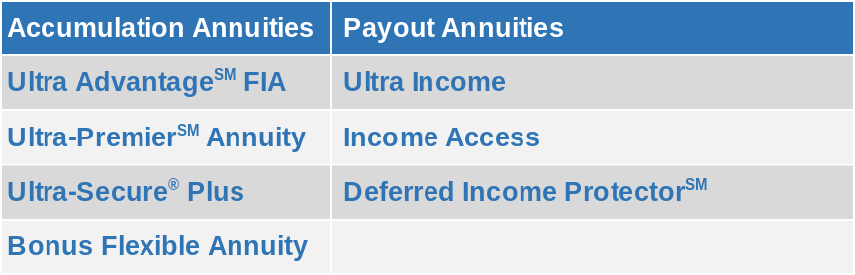
Mutual of Omaha’s Annuity Products*
* Underwritten by United of Omaha Life Insurance Company

Slide 9
Accumulation Annuities
Ultra AdvantageSM FIA, Ultra-PremierSM Annuity,
Ultra-Secure® Plus, and Bonus Flexible Annuity
Notes:
This can also be used as a title slide if there is no photo needed

Slide 10
> Ultra AdvantageSM FIA

Slide 11
Ultra AdvantageSM FIA
Ultra AdvantageSM FIA is a single premium deferred annuity (SPDA). It is considered a fixed indexed annuity, or FIA.
It is designed for long-term tax-deferred growth that can be used to accumulate both tax-qualified and nonqualified funds and offers interest crediting rates tied to a market index.

Slide 12
Ultra AdvantageSM FIA
Ultra AdvantageSM FIA is focused on accumulating funds for retirement. Guaranteed withdrawal benefits are not provided.
Being a “fixed” annuity means its value is protected from potential negative downturns in the market. This differentiates an FIA from a variable annuity or a registered index linked annuity (RILA) which can have negative returns.

Slide 13
Ultra AdvantageSM FIA
Ultra AdvantageSM FIA provides opportunity to participate in equity market returns without risk of loss
  Crediting options include market indexes tied to market indexes
  However, minimum guaranteed crediting rate for each index is 0%
  Potential to earn a higher return than a traditional fixed deferred annuity in exchange for some return volatility
In addition, Ultra AdvantageSM FIA provides a fixed account option that provides a fully guaranteed crediting option
  Client can allocate funds between the fixed account and the stock market indexes based on their personal risk tolerance

Slide 14
Ultra AdvantageSM FIA – Index Crediting Options
Ultra AdvantageSM FIA offers 5 index crediting strategies.
  S&P 500® One-Year 100% Participation¹
  S&P 500® 100% Participation with Guaranteed Cap¹
  S&P 500® One-Year Uncapped¹
  S&P 500® One-Year Performance Trigger¹
  BoA U.S. Agility Index: One-Year Uncapped²
All index crediting strategies use an annual point-to-point crediting methodology
  Crediting rate is determined by comparing the index value when the index crediting segment was created to the index value one year later.
  1 – See disclaimer on next slide
  2 – See disclaimer on next slide

Slide 15
Ultra AdvantageSM FIA – Index Disclaimers
1 – The S&P 500® Index is a product of S&P Dow Jones Indices LLC or its affiliates (“SPDJI”) and has been licensed for use by United of Omaha Life Insurance Company. Standard & Poor’s® and S&P® are registered trademarks of Standard & Poor’s Financial Services LLC (“S&P”); Dow Jones® is a registered trademark of Dow Jones Trademark Holdings LLC (“Dow Jones”); and these trademarks have been licensed for use by SPDJI and sublicensed for certain purposes by United of Omaha Life Insurance Company. United of Omaha Life Insurance Company’s fixed indexed annuity product(s) is not sponsored, endorsed, sold or promoted by SPDJI, Dow Jones, S&P, their respective affiliates, and none of such parties make any representation regarding the advisability of investing in such product(s) nor do they have any liability for any errors, omissions, or interruptions of the S&P 500® Index.
² BofA Securities Inc. and its affiliates (“BofAS”), BofA U.S. Agility Index (the “Index”) and related information, the name “BofAS”, and related trademarks, are intellectual property of BofAS, licensed from BofAS to United of Omaha Life Insurance Company (collectively, the “Licensee”). Neither the Licensee nor any fixed indexed annuity, indexed universal life insurance product or any other annuity product (collectively, the “Product”) referencing the Index is sponsored, operated, endorsed, sold or promoted by BofAS. Obligations to make payments under any Product are solely the obligation of Licensee pursuant to the term of the contract between Licensee and you, and are not the responsibility of BofAS. BofAS, the Index and related information, the names of BofAS and its affiliates, and related trademarks may not be copied, used, or distributed without BofAS’s prior written approval. The Products have not been passed on as to their legality or suitability, and are not regulated, issued, endorsed, sold, guaranteed, or promoted by BofAS. BofAS’s only relationship to Licensee is the licensing (or sub-licensing) of certain trademarks and trade names and the Index or components thereof and BofAS is not party to any transaction contemplated herein. While volatility controls may result in less fluctuation in rates of return as compared to products or indices without volatility controls, they may also reduce the overall rate of return as compared to products or indices not subject to volatility controls. BOFAS MAKES NO WARRANTIES AND BEARS NO LIABILITY WITH RESPECT TO THE INDEX, ANY RELATED INFORMATION, THE TRADEMARKS, OR THE PRODUCT(S) (INCLUDING WITHOUT LIMITATION, THEIR QUALITY, ACCURACY, SUITABILITY AND/OR COMPLETENESS).

Slide 16
Ultra AdvantageSM FIA – Index Crediting Parameters
Amounts allocated to an index crediting strategy will receive the index return as the crediting rate subject to these parameters:
  Participation rate
    Percentage of the index return applied to the crediting rate
  Cap rate
    The maximum index return applied to the crediting rate
  Trigger rate
    The crediting rate to be applied if the index return is positive
  Floor rate
    The minimum crediting rate for the index crediting strategy
    The floor rate is 0% for all index crediting strategies, guaranteeing the crediting rate will never be negative

Slide 17
Ultra AdvantageSM FIA – Index Crediting Options
S&P 500® One-Year 100% Participation¹ strategy
  Declared cap rate guaranteed for one year
  Participation rate guaranteed to be 100%
  Guaranteed minimum on renewal cap rates is 1%
S&P 500® 100% Participation with Guaranteed Cap¹ strategy
  Declared cap rate guaranteed for the entire surrender charge period
  Participation rate guaranteed to be 100%
  Guaranteed minimum on renewal cap rates beyond the surrender charge period is 1%
  Available for new money only – no transfers in allowed
S&P 500® One-Year Uncapped¹ strategy
  Declared participation rate guaranteed for one year
  Guaranteed minimum on renewal participation rates is 10%

Slide 18
Ultra AdvantageSM FIA – Index Crediting Options
S&P 500® One-Year Performance Trigger¹ strategy
  Credits the trigger rate if the S&P 500 return is positive
  Declared trigger rate guaranteed for one year
  Guaranteed minimum on renewal trigger rates is 1%
BoA US Agility Index: One-Year Uncapped² strategy
  Volatility control index, uncapped
  Declared participation rate guaranteed for one year
  Guaranteed minimum on renewal participation rates is 25%

Slide 19
Ultra AdvantageSM FIA – Index Crediting Examples
Assume the S&P 500® index value at the beginning of the annual point-to-point index crediting segment is 5,000. The table below shows the various interest crediting rates that would result from various index return values and index crediting strategies.
Index Value | Index return | Crediting Rate
 |  | 100% Par 8% Cap | 50% Par Uncapped | 100% Par 5% Trigger
6,000 | 20.00% | 8.00% | 10.00% | 5.00%
5,500 | 10.00% | 8.00% | 5.00% | 5.00%
5,250 | 5.00% | 5.00% | 2.50% | 5.00%
5,001 | 0.02% | 0.02% | 0.01% | 5.00%
4,900 | -2.00% | 0.00% | 0.00% | 0.00%

Slide 20
Ultra AdvantageSM FIA
Issue ages:
  5-year: 0-85
  7-year: 0-85
  10-year: 0-80
Premiums:
  $10,000 is the minimum purchase amount
  $3 million is the maximum purchase amount. Higher amounts are possible but require home office approval.
  Policy additions are allowed within the first policy year only, with a minimum amount of $500 per addition.

Slide 21
Ultra AdvantageSM FIA – Surrender Charges
Surrender Charges
5-Year | Year 1 | Year 2 | Year 3 | Year 4 | Year 5
Charge | 9% | 9% | 8% | 7% | 6%
7-Year | Year 1 | Year 2 | Year 3 | Year 4 | Year 5 | Year 6 | Year 7
Charge | 9% | 9% | 8% | 7% | 6% | 5% | 4%
10-Year | Year 1 | Year 2 | Year 3 | Year 4 | Year 5 | Year 6 | Year 7 | Year 8 | Year 9 | Year 10
Charge | 9% | 9% | 8% | 7% | 6% | 5% | 4% | 3% | 2% | 1%
Surrender charges do not reset, so become 0% beyond the years shown above.

Slide 22
Ultra AdvantageSM FIA – Free Withdrawals
Ultra AdvantageSM FIA offers a cumulative free withdrawal provision
  Free withdrawal amount is 10% of premium in first policy year
  Any unused portion of the free withdrawal amount at the end of a policy year is carried over to the next policy year – the cumulative free withdrawal amount
  Free withdrawal amount for each renewal year equals
    10% of the accumulation value at the end of the previous policy year
    Plus the cumulative free withdrawal amount
  Free withdrawal amount is capped at 25% of the accumulation value

Slide 23
Ultra AdvantageSM FIA – Optional Return of Premium (ROP)
Ultra AdvantageSM FIA offers an optional return of premium (ROP) benefit via a rider. The rider provides the following benefits:
  Surrender value will never be less than the purchase payments*
  100% of remaining premiums can be returned at any time*
There is no fee for the rider, but the interest crediting parameters will generally be lower than for policies without the ROP rider
*Minus any withdrawals and any applicable premium tax

Slide 24
Ultra AdvantageSM FIA – Market Value Adjustment (MVA)
A market value adjustment, or MVA, may apply to a cash surrender or partial withdrawal.
  The MVA is determined based on changes to the U.S. Treasury rate corresponding to the term (length of surrender charge period) of the policy. So, the 5-year U.S. Treasury rate is used for a policy using the 5-year surrender charge period, etc.
  If the applicable U.S Treasury rate at the time of the surrender or withdrawal is higher than it was at policy issue, the MVA will be downward.
  If the applicable U.S Treasury rate at the time of the surrender or withdrawal is lower than it was at policy issue, the MVA will be upward.
  The MVA is not applied to the free withdrawal amount or any death benefit. In addition, there will be no MVA after the surrender charge period ends or if the contract is annuitized after the second policy year.

Slide 25
Ultra AdvantageSM FIA – Waiver of Withdrawal Charges
Surrender charges or market value adjustment will NOT apply if the withdrawal is for any of the following*:
  Confinement to a Hospital, Nursing Home or Long-Term Care Facility
  Unemployment
  Disability
  Terminal illness
  Death of a Spouse or Minor Dependent
  Damage to Residence
  Transplant Surgery
* Waiver provisions have some restrictions and limitations which are described in the contract.

Slide 26
Ultra AdvantageSM FIA – Death Benefit
The death benefit equals the accumulation value on the date of the owner’s death, minus any applicable premium taxes. No withdrawal charges apply to the death benefit.

Slide 27
Ultra AdvantageSM FIA – Maturity
Contracts mature no later than the policy anniversary following the annuitant’s age 95. At maturity, the policy owner must either annuitize or surrender the policy for its full surrender value.
The contract owner may elect to annuitize earlier than the maturity date.

Slide 28
> Ultra-PremierSM Annuity

Slide 29
Ultra-PremierSM Annuity
Ultra-PremierSM Annuity is a single premium deferred annuity (SPDA) with either a five-year or a seven-year rate guarantee. It is considered a multi-year guarantee annuity, or MYGA.
It is designed for long-term tax-deferred growth that can be used to accumulate both tax-qualified and nonqualified funds and offers our most competitive interest crediting rate.

Slide 30
Ultra-PremierSM Annuity
Issue ages:
5-year: 0-89
7-year: 0-88
Premiums:
$25,000 is the minimum purchase amount
$3 million is the maximum purchase amount. Higher amounts are possible but require home office approval.
Policy additions are allowed within the first policy year only, with a minimum amount of $500 per addition.

Slide 31
Ultra-PremierSM Annuity – Surrender Charges
Surrender Charges
“Free Withdrawals” – Annual withdrawals of up to 10% of the account value with no surrender charge are available immediately.
Ultra-Premier does NOT have a return of premium (ROP) feature.
5-Year | Year 1 | Year 2 | Year 3 | Year 4 | Year 5
Charge | 9% | 9% | 8% | 7% | 6%
7-Year | Year 1 | Year 2 | Year 3 | Year 4 | Year 5 | Year 6 | Year 7
Charge | 9% | 9% | 8% | 7% | 6% | 5% | 4%

Slide 32
Ultra-PremierSM Annuity – Market Value Adjustment (MVA)
A market value adjustment, or MVA, may apply to a cash surrender or partial withdrawal.
  If the current new money interest rate at the time of the surrender or withdrawal is higher than the multi-year guaranteed interest rate, the MVA will be downward.
  If the current new money interest rate at the time of the surrender or withdrawal is lower than the multi-year guaranteed interest rate, the MVA will usually be upward.
  The MVA is not applied to the 10% free withdrawal amount or any death benefit. In addition, there will be no MVA during the renewal period or if the contract is annuitized after the second policy year.
  The MVA does not apply to policies issued in California.

Slide 33
Ultra-PremierSM Annuity – Waiver of Withdrawal Charges
Surrender charges or market value adjustment will NOT apply if the withdrawal is for any of the following*:
  Confinement to a Hospital, Nursing Home or Long-Term Care Facility
  Unemployment
  Disability
  Terminal illness
  Death of a Spouse or Minor Dependent
  Damage to Residence
  Transplant Surgery
* Waiver provisions have some restrictions and limitations which are described in the contract. Not available in all states.

Slide 34
Ultra-PremierSM Annuity – Renewal Options
Ultra-PremierSM Annuity has a 30-day renewal period at the end of the multiyear guarantee period. During this 30-day window, the owner of the annuity has three choices:
  Begin a new multiyear guarantee period of the same length (surrender charge schedule and market value adjustment provisions restart)
  Begin a one-year guarantee period (the surrender charge schedule and market value adjustment provisions no longer apply)
  Surrender the contract or annuitize without any charges

Slide 35
Ultra-PremierSM Annuity – Death Benefit
The death benefit equals the accumulation value on the date of the owner’s death, minus any applicable premium taxes. No withdrawal charges apply to the death benefit.

Slide 36
Ultra-PremierSM Annuity – Maturity
Contracts mature no later than the policy anniversary following the annuitant’s age 95. At maturity, the policy owner must either annuitize or surrender the policy for its full surrender value.
The contract owner may elect to annuitize earlier than the maturity date.

Slide 37
> Ultra-Secure® Plus

Slide 38
Ultra-Secure® Plus
Ultra-Secure® Plus is a single premium deferred annuity (SPDA) with either a five-year or a seven-year rate guarantee. It is considered a multi-year guarantee annuity, or MYGA.
It is designed for long-term tax-deferred growth that can be used to accumulate both tax-qualified and nonqualified funds with a competitive long-term interest rate.

Slide 39
Ultra-Secure® Plus
Issue ages:
5-year: 0-89
7-year: 0-88
Premiums:
$5,000 is the minimum purchase amount
$3 million is the maximum purchase amount. Higher amounts are possible but require home office approval.
Policy additions are allowed within the first policy year only, with a minimum amount of $500 per addition.

Slide 40
Ultra-Secure® Plus – Crediting Rates
Ultra-Secure® Plus interest crediting rates:
  Client chooses either a five- or seven-year fixed rate guarantee period
  An additional 0.15%* is added to the crediting rate when accumulation values are $50,000 or higher
* Additional rate subject to change.

Slide 41
Ultra-Secure® Plus – Surrender Charges
“Free Withdrawals” – Annual withdrawals of up to 10% of the account value with no surrender charge are available immediately.
Surrender Charges
5-Year | Year 1 | Year 2 | Year 3 | Year 4 | Year 5
Charge | 6% | 6% | 6% | 6% | 5%
7-Year | Year 1 | Year 2 | Year 3 | Year 4 | Year 5 | Year 6 | Year 7
Charge | 6% | 6% | 6% | 6% | 5% | 4% | 3%

Slide 42
Ultra-Secure® Plus – Market Value Adjustment (MVA)
A market value adjustment, or MVA, may apply to a cash surrender or partial withdrawal.
  If the current new money interest rate at the time of the surrender or withdrawal is higher than the multi-year guaranteed interest rate, the MVA will be downward.
  If the current new money interest rate at the time of the surrender or withdrawal is lower than the multi-year guaranteed interest rate, the MVA will usually be upward.
  The MVA does not apply to the 10% free withdrawal amount or any death benefit. In addition, there will be no MVA during the renewal period or if the contract is annuitized after the first 2 policy years.

Slide 43
Ultra-Secure® Plus – Waiver of Withdrawal Charges
Surrender charges or market value adjustment will NOT apply if the withdrawal is for any of the following*:
  Confinement to a Hospital, Nursing Home or Long-Term Care Facility
  Unemployment
  Disability
  Terminal illness
  Death of a Spouse or Minor Dependent
  Damage to Residence
  Transplant Surgery
* Waiver provisions have some restrictions and limitations which are described in the contract. Not available in all states.

Slide 44
Ultra-Secure® Plus – Return of Premium (ROP)
Ultra-Secure Plus has a return of premium, or ROP, benefit.
  Surrender value will never be less than the purchase payments*
  100% of remaining premiums can be returned at any time*
  Renews at time of contract renewal and guarantees the client the accumulation value at the time of the most recent renewal date*
*Minus any withdrawals and any applicable premium tax

Slide 45
Ultra-Secure® Plus – Renewal Options
Ultra-Secure® Plus has a 30-day renewal period at the end of the multiyear guarantee period. During this 30-day window, the owner of the annuity has three choices:
  Begin a new multiyear guarantee period of the same length (surrender charge schedule and market value adjustment provisions restart)
  Begin a one-year guarantee period (the surrender charge schedule and market value adjustment provisions no longer apply)
  Surrender or annuitize the contract without any charges

Slide 46
Ultra-Secure® Plus – Death Benefit
The death benefit equals the accumulation value on the date of the owner’s death, minus any applicable premium taxes. No withdrawal charges apply to the death benefit.

Slide 47
Ultra-Secure® Plus – Maturity
Contracts mature no later than the policy anniversary following the annuitant’s age 95. At maturity, the policy owner must either annuitize or surrender the policy for its full surrender value.
The contract owner may elect to annuitize earlier than the maturity date.

Slide 48
Ultra-PremierSM Annuity vs. Ultra-Secure® Plus
Benefits | Ultra-PremierSM Annuity | Ultra-Secure® Plus
Description | Single Premium Deferred Annuity | Single Premium Deferred Annuity
Issue Ages | 5-year: 0-89 7-year: 0-88 | 5-year: 0-89 7-year: 0-88
Minimum Premium | $25,000 minimum initial deposit with $500 minimum additions in first policy year | $5,000 minimum initial deposit with $500 minimum additions in first policy year
Return of Premium | No | Yes
Interest Bonus | None | Additional interest added to accumulation values of $50,000 or higher
Liquidity | 10% annual withdrawal with no withdrawal charges | 10% annual withdrawal with no withdrawal charges
Death Benefit | Accumulation value less any applicable premium taxes | Accumulation value less any applicable premium taxes
Withdrawal Charges | Surrender charge and market value adjustment applicable during Guarantee Period (5/7 years) | Surrender charge and market value adjustment applicable during Guarantee Period (5/7 years)
Other Benefits | Higher credited rates than Ultra-Secure Plus | Competitive crediting rates Better liquidity than Ultra-Premier with return of premium provision and lower surrender charges

Slide 49
> Bonus Flexible Annuity

Slide 50
Bonus Flexible Annuity
Bonus Flexible Annuity, or BFA, is designed specifically for the accumulation of funds for both tax-qualified and nonqualified plans.
It is a flexible premium deferred annuity with a fixed interest rate and flexible contribution options.

Slide 51
Bonus Flexible Annuity
Issues ages: 0-89
Premium:
  $1,200 minimum annual contribution for recurring premiums
  $5,000 minimum for single premium
  $1 million is the maximum purchase amount. Higher amounts are possible but require home office approval.
Contributions are flexible and may be increased or decreased at any time subject to a minimum of $100 per month.

Slide 52
Bonus Flexible Annuity – Crediting Rates
Cash value accumulates at a current interest rate
Contributions receive an additional 1%* in addition to the current rate during the first 12 months for all new deposits made
After 12 months, the deposits receive the stated current interest rate, but not the first year additional 1%*
Additional 0.15%* added to the interest rate on accumulation values of $50,000 or more
* These values are subject to change.

Slide 53
Bonus Flexible Annuity – Surrender Charges
Up to 10% of the cash value can be withdrawn annually with no surrender charge
Minimum withdrawal is $100
The accumulation value cannot be less than $5,000 after the withdrawal
Withdrawals in excess of the annual 10% free withdrawal amount are subject to applicable surrender charges in the first 8 policy years (shown below)
There is no market value adjustment on this product
Surrender Charges
Year | 1 | 2 | 3 | 4 | 5 | 6 | 7 | 8
Charge | 8% | 8% | 7% | 6% | 5% | 4% | 3% | 2%

Slide 54
Bonus Flexible Annuity – Systematic Withdrawals
A systematic withdrawal feature can provide a regular income stream
Systematic withdrawal options are interest only or fixed amount
The income withdrawals can be as low as $100 and can be monthly, quarterly, semiannually or annually
Withdrawal charges apply to systematic income withdrawals that exceed 10% of the accumulation value during the first 8 policy years
The request for systematic withdrawals can be made at any time by completing the appropriate form

Slide 55
Bonus Flexible Annuity – Death Benefit
The death benefit is equal to the accumulation value less any applicable premium taxes. No withdrawal charges apply to the death benefit.

Slide 56
Deferred Annuity Portfolio Recap
Benefits | Ultra-PremierSM Annuity | Ultra-Secure® Plus | Bonus Flexible Annuity
Description | Single Premium Deferred Annuity | Single Premium Deferred Annuity | Flexible Premium Deferred Annuity
Issue Ages | 5-year: 0-89 7-year: 0-88 | 5-year: 0-89 7-year: 0-88 | 0-89
Minimum Premium | $25,000 minimum initial deposit with $500 minimum additions in first policy year | $5,000 minimum initial deposit with $500 minimum additions in first policy year | $1,200 annual contribution, or $5,000 for single premium
Return of Premium | No | Yes | No
Interest Bonus | None | 0.15%* additional interest added to accumulation values $50,000 or higher | 1%* additional interest rate in the first year. 0.15%* additional interest added to accumulation values of $50,000 or higher
Liquidity | 10% annual withdrawal with no withdrawal charges | 10% annual withdrawal with no withdrawal charges | 10% annual withdrawal with no surrender charge
Death Benefit | Accumulation value less any applicable premium taxes | Accumulation value less any applicable premium taxes | Accumulation value less any applicable premium taxes
Withdrawal Charges | Surrender charge and market value adjustment applicable during Guarantee Period (5/7 years) | Surrender charge and market value adjustment applicable during Guarantee Period (5/7 years) | Surrender charge applicable through year 8
Other Benefits | Higher credited rates than Ultra-Secure Plus | Competitive rates Better liquidity than Ultra-Premier with return of premium provision and lower surrender charges | Flexible payment options Systematic withdrawal options Competitive payouts
* Additional interest rates are subject to change

Slide 57
Payout Annuities
Ultra Income, Income Access, and
Deferred Income ProtectorSM
Notes:
This can also be used as a title slide if there is no photo needed

Slide 58
Payout Annuities
Single Premium Immediate Annuities (SPIA)
  Ultra Income – Traditional SPIA with multiple payout options
  Income Access – Unique SPIA with liquidity and enhanced payout features
Deferred Income Annuity (DIA)
  Deferred Income ProtectorSM – Traditional DIA with multiple payout options

Slide 59
> Ultra Income

Slide 60
Ultra Income
Ultra Income is a Single Premium Immediate Annuity (SPIA).
The owner chooses when Income Payments begin, as early as the very next month, or they may be postponed up to 13 months.

Slide 61
Ultra Income
Issue ages: 0-85
Premiums
  The minimum single premium is $10,000
  The maximum single premium is $3,000,000. Higher amounts are possible but require Home Office approval.

Slide 62
Ultra Income – Income Payments
Income payments may be made monthly, quarterly, semiannually, or annually
The minimum payment is $100
Income payments must begin between 1 and 13 months of the purchase date
An optional annual cost-of-living adjustment is available up to 6% of the initial annual income payment

Slide 63
Ultra Income – Payout Options
  Life Only
    Income payments continue until the annuitant’s death
    There is no death benefit
  Life with Period Certain
    Income payments continue at least until the annuitant’s death
    Upon the annuitant's death, income payments continue to the beneficiary until the policy has been inforce for the specified certain period
    If the annuitant dies after the certain period has expired, there is no death benefit
    The certain period can be a minimum of 5 years and a maximum of 20 years
  Guarantee Period Only
    Income payments continue for the specified certain period – they are not life contingent
    If the annuitant dies before the certain period has expired, income payments continue to the beneficiary for the remainder of the certain period
    The certain period can be a minimum of 5 years and a maximum of 20 years

Slide 64
Ultra Income – Payout Options
  Installment refund
    Income payments continue at least until the annuitant’s death
    Upon the annuitant's death, income payments continue to the beneficiary until the original premium has been recovered
    If the annuitant dies after the original premium has already been recovered, there is no death benefit
  Joint and survivor life
    Income payments continue until the second joint annuitant dies
    Upon the first death, income payments continue to the surviving annuitant at 50-100% of the initial income payment (survivorship percentage selected at policy issue)
    There is no death benefit after the second death
  Joint and survivor life with period certain
    The certain period can be a minimum of 5 years and a maximum of 20 years
  Temporary (life contingent)

Slide 65
Ultra Income – Age Rating
Age Rating for Impaired Risk/Substandard
  Age rating increases the monthly payments for clients with health problems and a medical history that lowers their life expectancy. Twelve months of medical records are required for Underwriting to determine a rated age.
Example
  A 65-year-old man has severe emphysema
  Underwriting reviews his medical history and determines his life expectancy is like that of a 72-year-old and assigns him a Rated Age of 72
  Using the Rated Age of 72, his benefit is higher than it would have been using his actual age of 65

Slide 66
> Income Access

Slide 67
Income Access
Income Access is a Single Premium Immediate Annuity (SPIA) that provides a lifetime guaranteed income with a return of remaining premium death benefit that provides its owner liquidity and enhanced payout options.
It offers a package of several optional benefits.

Slide 68
Income Access
Issue ages: 0-75
Premiums
  The minimum singe premium is $10,000
  The maximum single premium is $1,000,000. Higher amounts are possible but require Home Office approval.

Slide 69
Income Access
Benefit payments may be made monthly, quarterly, semiannually or annually
The minimum periodic payment is $100
Payouts must begin between 1 and 13 months of the purchase date
Income Access offers a guaranteed lifetime income payout to the annuitant. Generally, the lifetime income from Income Access will be less than the comparable lifetime income from Ultra Income due to the death benefit and liquidity features offered by Income Access.
No period certain or installment refund options are offered

Slide 70
Income Access – Death Benefits
Death Benefit Options (subject to state availability)
  Return of premium death benefit (standard policy benefit)
    Any remaining premiums not yet received as income payments will be paid to the beneficiary(ies)
  Guaranteed minimum death benefit rider (optional benefit)
    Policy will pay the greater of any remaining premiums not yet received as income payments or 10% of the initial premium
    If the entire premium amount has been recovered through income payments, the beneficiaries will receive 10% of the initial premium as the death benefit

Slide 71
Income Access – Death Benefits
Death Benefit Options (continued)
  Accidental death benefit rider (optional benefit)
    Pays double the death benefit upon accidental death in a plane, train, taxi or other common carrier
  Survivor continuation rider (optional benefit)
    Offers the continuation of the annual income benefit to the surviving spouse/relative/business partner/companion

Slide 72
Income Access – Payout Options
Increased Payout Options (subject to state availability)
  Inflation Protection Rider (optional benefit)
    3% annual inflation protection
  Enhanced Payment Nursing Home Rider (optional benefit)
    50% payment increase for nursing home confinement for five years

Slide 73
Income Access – Access to Funds
Liquidity Features (subject to state availability)
  Partial return of premium on cancellation
    Allows the owner to cancel the contract and receive a lump-sum of any remaining premium not yet received as income payments. Only a partial return of premium will be paid in the first five policy years (subject to a vesting schedule).
  Return of premium for terminal illness
    Allows the owner to receive the return of premium death benefit up to 12 months early, without being subject to the vesting schedule.

Slide 74
> Deferred Income ProtectorSM

Slide 75
Deferred Income ProtectorSM
Deferred Income ProtectorSM is a Deferred Income Annuity (DIA) which is a “pension-like” annuity that:
  Provides clients with a guaranteed fixed amount of monthly income that they will begin receiving several years in the future, and
  Affords protection against constantly fluctuating interest rates and provides higher income payments relative to a SPIA

Slide 76
Deferred Income ProtectorSM
Deferred Income ProtectorSM is a versatile annuity that allows individuals to invest a portion of their assets to secure a portion of their retirement needs.
It also serves clients who are looking for a longevity product that provides security against outliving their existing assets at advanced ages.

Slide 77
Deferred Income ProtectorSM - QLAC
Qualified Longevity Annuity Contracts (QLACs):
  Are fixed-rate deferred annuities that can be sold with certain types of employer-sponsored retirement plans and IRAs
  Individuals may allocate up to $210,000 per year into a QLAC, diverting a portion of their qualified funds for later use
  Reduces the required minimum distributions (RMDs) the individual must start taking at age 73
  Must start taking distributions no later than age 85

Slide 78
Deferred Income ProtectorSM
The target market is ages 55-65
  those approaching retirement age
  planning to retire in the next 5 to 10 years

Slide 79
Deferred Income ProtectorSM
Issue ages:
  40-75 for Non-Qualified and QLAC plans
  40-71 for Qualified plans

Slide 80
Deferred Income ProtectorSM
The minimum initial premium is $5,000
Additional purchase payments may be added at any time until two years before the Income Start Date
The minimum additional purchase amount is $2,000
The sum of all purchase payments may not exceed $3,000,000 without Home Office approval

Slide 81
Deferred Income ProtectorSM
Surrenders are not allowed. This contract does not provide access to funds prior to the income start date, other than payment of the death benefit, if any.

Slide 82
Deferred Income Protector – Income Start Date
Income Start Date selected on the application:
  Must be at least 2 years from the most recent purchase payment and no more than 40 years from issue date
  Payments must start by age 73 if qualified, or age 85 if non-qualified or a QLAC
  May be changed one time to move the Income Start Date up to 5 years earlier or later than originally selected
  A change in Income Start Date will result in a change in the Income Payment Amount

Slide 83
Deferred Income ProtectorSM – Income Options
Life (or Joint Life) only
    Income payments continue until the annuitant(s) dies
    There is no death benefit
Life (or Joint Life) with Cash Refund
    If the annuitant(s) dies during the deferral period, the death benefit is a return of premium
    If the annuitant(s) dies after income payments start, the death benefit is the original premium less the income payments already received
    If the annuitant(s) dies after the original premium has already been recovered, there is no death benefit

Slide 84
Deferred Income Protector – Income Options
Life (or Joint Life) with Period Certain*
    If the annuitant(s) dies during the deferral period, the death benefit is a return of premium
    If the annuitant(s) dies after income payments start but before the certain period has expired, income payments continue to the beneficiary until the certain period has expired
    If the annuitant(s) dies after the certain period has expired, there is no death benefit
    The certain period can be a minimum of 5 years and a maximum of 20 years
Life (or Joint Life) with Installment Refund*
    If the annuitant(s) dies during the deferral period, the death benefit is a return of premium
    If the annuitant(s) dies after income payments start, income payments continue to the beneficiary until the original premium has been recovered
    If the annuitant(s) dies after the original premium has already been recovered, there is no death benefit
*Not allowed on QLAC contracts

Slide 85
Deferred Income ProtectorSM – Death Benefit
Death Benefit:
  Life Only: None
  Life with Period Certain: If death prior to income start date, lump sum full return of premium. If death after income start date, income payments continue to beneficiary until certain period has expired.
  Cash Refund: Lump sum return of premium less any income payments received
  Installment Refund: If death prior to income start date, lump sum full return of premium. If death after income start date, income payments continue to beneficiary until initial premium is recovered.

Slide 86
Deferred Income ProtectorSM
The Income Advance feature:
  Only available on monthly payments
  Allows the owner to receive the next scheduled monthly payment along with 6 subsequent payments for a total of 7 months of income payments paid in one lump sum
  May be exercised three times during the life of the contract

Slide 87
Deferred Income ProtectorSM
Annual Income Increase Option:
  Must be elected at the time of application
  Allows policyowners to increase income payments by 1% - 3% annually
  Annual increases begin on the Income Start Date

Slide 88
Deferred Income ProtectorSM
Income Reduction for Surviving Spouse allows the income payment to be reduced after the death of one annuitant.

Slide 89
Deferred Income ProtectorSM
There is no contract fee
Rated age and impaired risk underwriting are NOT available

Slide 90
Payout Annuity Portfolio Recap
Benefits | Ultra Income | Income Access | Deferred Income ProtectorSM
Product Description | SPIA with competitive rates and multiple income options | Life with Cash Refund SPIA with liquidity options | DIA with multiple income options “Pension-like” annuity
Issue Ages | 0-85 | 0-75 | 40-75 for Non-Qualified and QLAC, 40-71 for Qualified
Client Profile | 65+ | 65+ | 55-65 approaching retirement
Minimum Initial Premium | • $10,000 single premium | • $10,000 single premium | $5,000
Minimum Income Amount | • $100 monthly | • $100 monthly
Minimum Additional Premium | n/a | n/a | $2,000

Slide 91
Payout Annuity Portfolio Recap
Benefits | Ultra Income | Income Access | Deferred Income ProtectorSM
Liquidity | n/a | Return of premium features | n/a
Deferral Period | 1-13 months | 1-13 months | 2-40 years (Income payments must begin by age 73 if Qualified or by age 85 if Non-Qualified/QLAC)
Income Start Date | 1-13 months from purchase date | 1-13 months from purchase date | At least 2 years from most recent purchase date (may be changed once to move date 5 years earlier or later)
Other Available Features | • Age Rating • 0-6% Cost of Living Adjustment (COLA) • Flexible payment frequency | • Inflation Protection Rider • Enhanced Payment • Nursing Home Rider • Flexible payment frequency | • Income Advance Feature • Annual Income Increase Option (1-3%) • Income Reduction for Surviving Spouse

Slide 92
Payout Annuity Portfolio Recap
Benefits | Ultra Income | Income Access | Deferred Income ProtectorSM
Death Benefit | Benefit options available to continue benefit payments to the beneficiary if death occurs prior to the end of the guarantee period | • Return of remaining premium at death • Guaranteed minimum death benefit (optional) • Death Benefit doubles for Accidental Death (optional) | • Life Only: none • Cash & Installment Refund: Return of remaining premium • Period Certain: Payments continue to end of guarantee period
Withdrawal Charges | Withdrawals not allowed | Vesting schedule for early withdrawal | Withdrawals not allowed

Slide 93
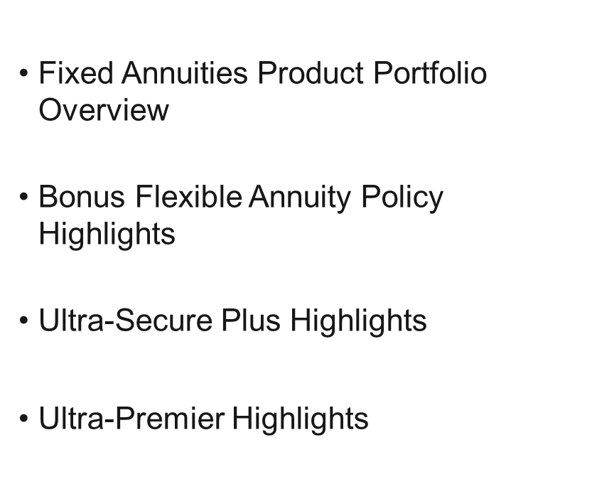
Resources

Slide 94
Mutual of Omaha Individual Annuities
Suitability
Notes:
This can also be used as a title slide if there is no photo needed

Slide 95
NAIC Suitability in Annuity Transactions Model Regulation
In recommending the purchase or exchange of an annuity, producers must act in the best interest of the consumer so that the insurance needs and financial objectives of the consumer at the time of the transaction are effectively addressed. A producer has acted in the best interest of the consumer if they have satisfied specific care, disclosure, conflict of interest, and documentation obligations.

Slide 96
NAIC Suitability in Annuity Transactions Model Regulation
To meet the care obligation, the producer must make reasonable efforts to obtain consumer profile information concerning:
  The consumer’s financial situation, insurance needs and financial objectives
  The consumer’s tax status
  The consumer’s risk tolerance, and
  Any other information used or considered to be reasonable in making the recommendation to the consumer

Slide 97
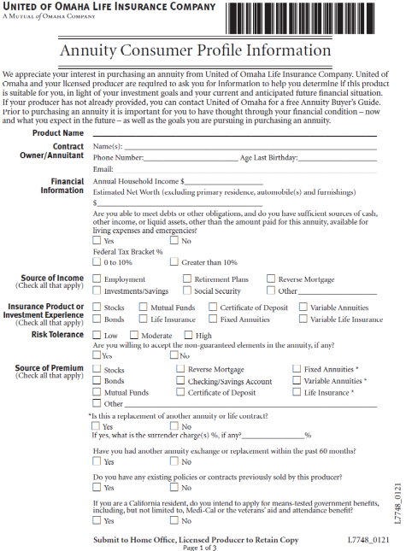
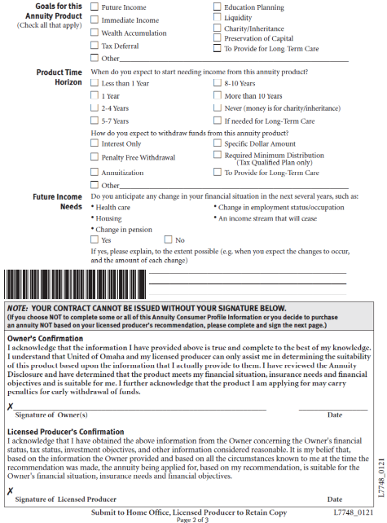

Consumer Profile Information Form
This form is required to be completed and signed by the applicant and must be submitted with the application before an annuity can be issued.

Slide 98
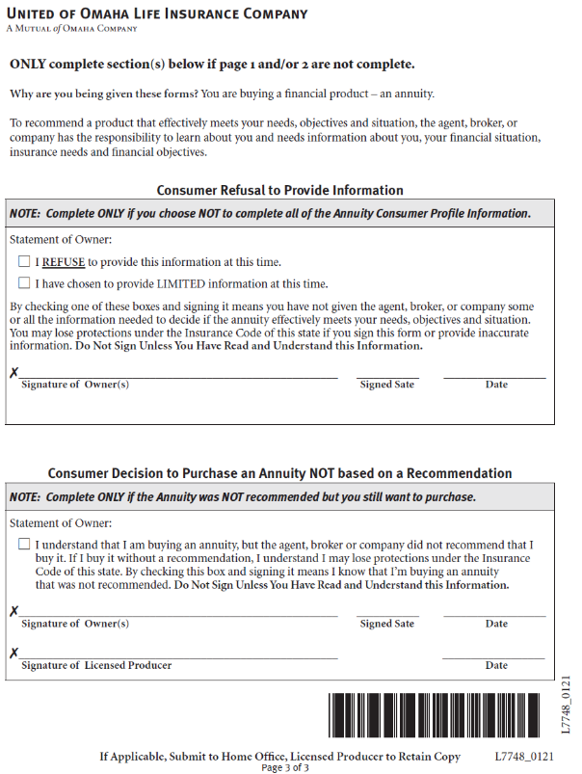
Consumer Profile Information Form
This optional additional page of the
Consumer Profile Information Form
must be signed by the client if they
decide not to provide some or all
the requested information, or if they
decide to purchase the annuity with-
out your recommendation.

Slide 99
Mutual of Omaha Individual Annuities
Disclosure
Notes:
This can also be used as a title slide if there is no photo needed

Slide 100
Disclosures
Consumers must be given a product disclosure about the specific annuity being offered for purchase.
Consumers must also be given a producer disclosure regarding the products and providers you are authorized to sell and how you will be compensated.
These disclosures review important points that the client needs to consider before purchasing the annuity.

Slide 101
Disclosures
Some of the topics the product disclosure will cover include:
  Type of annuity
  Benefits
  Annuity starting date
  Fees, expenses and other charges
  Withdrawal charges, if applicable
  Taxes
  Miscellaneous information

Slide 102
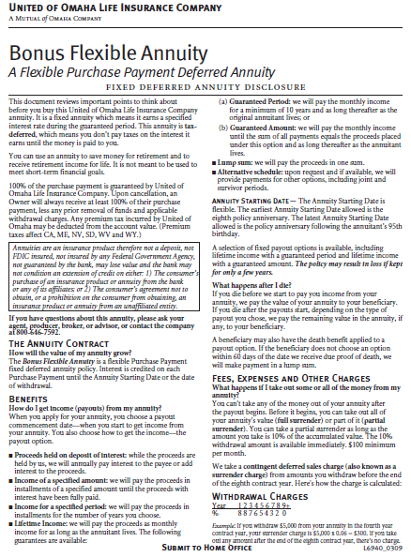
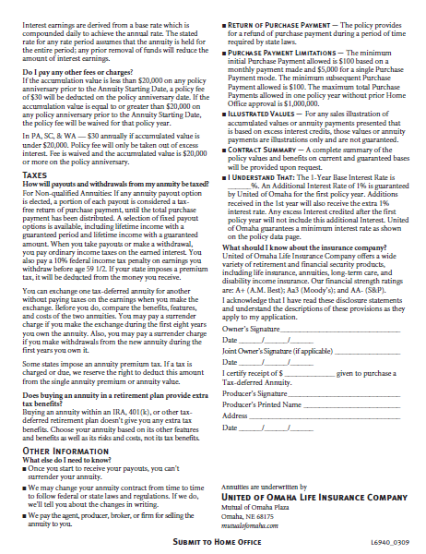
Disclosures
The appropriate product
disclosure forms must
be provided to the
consumer. They must be
completed and signed.
An example is provided
here.

Slide 103
Disclosures
Some of the topics the producer disclosure will cover include:
  Your business / contact information
  Types of products you are licensed to sell
  The number of companies whose annuities you are authorized to sell
  How you are paid for your work

Slide 104
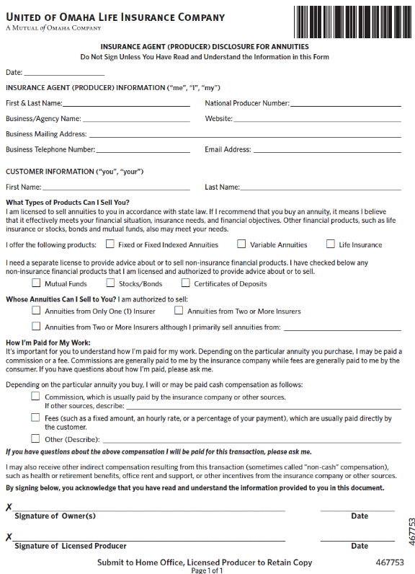
Disclosures
The producer disclosure form
must be filled out and provided
to the consumer, and they
must sign it.

Slide 105
Disclosure
As you make a recommendation for an annuity to a client, it is important that you have reasonable grounds that the recommendation is suitable for the client based on the facts disclosed by the client.

Slide 106
Mutual of Omaha Individual Annuities
Replacements
Notes:
This can also be used as a title slide if there is no photo needed

Slide 107
Replacements
Replacement of existing coverage should occur only when it is in the best interest of the consumer.
You need to be able to assist the client in evaluating whether a replacement is in his or her best interest.

Slide 108
Replacements
When completing the application if the applicant answers “yes” to the question regarding existing coverage and coverage will be replaced or used to fund the new contract, the client must be given a replacement notice.
In addition, the application should list the name of the insurer, insured or annuitant, and the policy or contract number of the policy being replaced, if available.

Slide 109
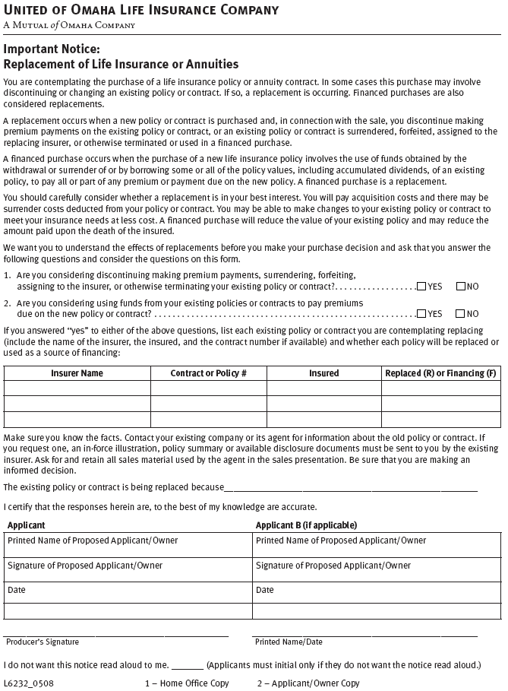
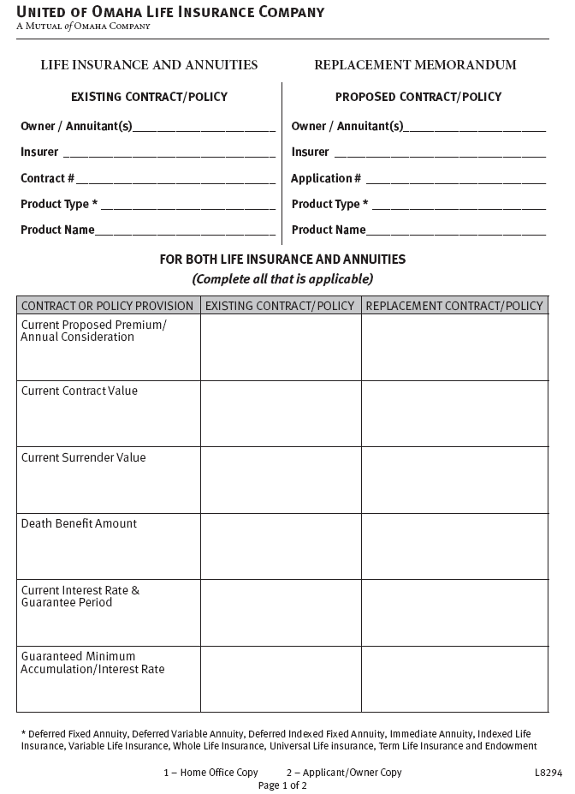
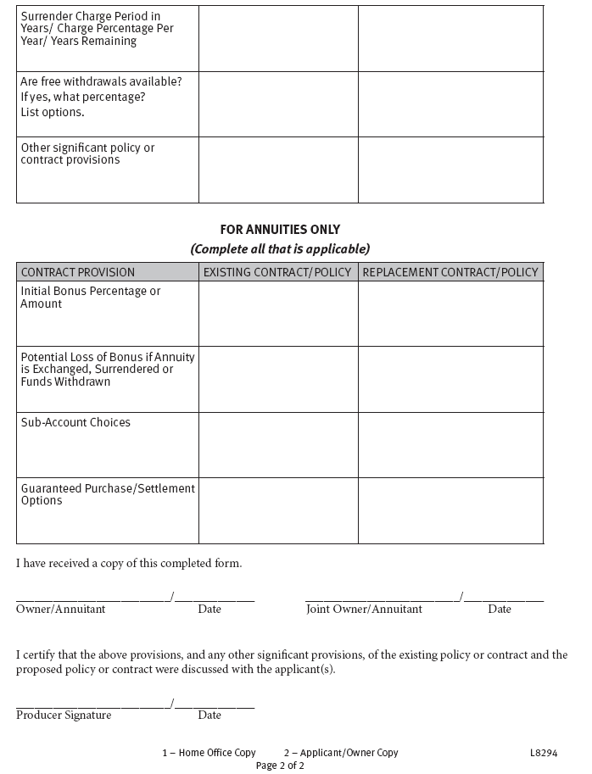
Replacements
A copy must be provided to the client and submitted with the application

Slide 110
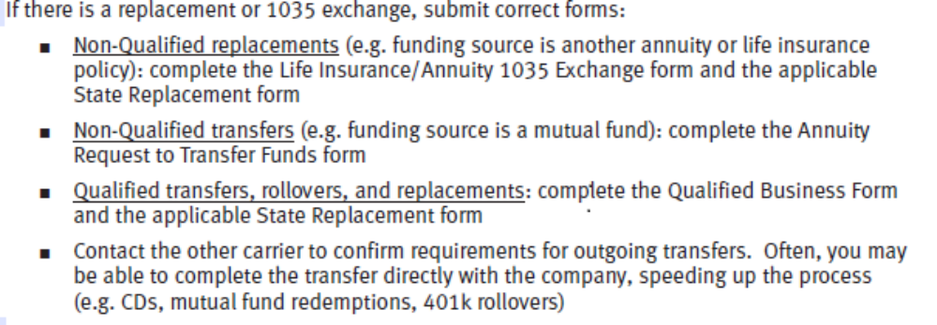
Replacements
Submit the correct forms for a replacement or 1035 exchange.

Slide 111
Replacements
Remember, in making a recommendation, the producer must have reasonable grounds to believe the recommendation is in the client’s best interest based on the facts the client has disclosed about his or her financial situation, insurance needs and financial objectives.

Slide 112
> Wrap-up

Slide 113
Annuity Checklist
When selling an annuity be sure to:
  Submit the completed application and any applicable proposal (illustration)
  Complete and submit the Annuity Consumer Profile Information form
  Complete and submit the appropriate product and producer disclosure statements
  If there is a replacement or 1035 exchange, submit the correct forms
  Provide a copy of the “Buyer’s Guide to Annuities” to the client (where required)

Slide 114
Certification and Acknowledgement Form
Close this window, scroll down the SPA page to locate, complete and submit form noted below.
Questions? Contact 1-800-867-6873

