Slide 1
Trailhead FIA and
Trailhead FIA PLUS
Fixed Indexed Annuity
Product Training
This training manual is intended for Producers authorized to do business with AmFirst Insurance Company.
Products are marketed and serviced by Axonic Insurance Services, LLC. The material contained herein has not been approved for use with the general public and may not be reproduced. This course is intended to give an overview of the Axonic Trailhead Fixed Indexed Annuity and Axonic Trailhead Fixed Indexed Annuity PLUS and is current as of December 31, 2025.
AXI-09-006
1225-0128
Intended for Financial Professionals Only. Not intended for public distribution.
1 of 26

Slide 2
Trailhead FIA / Trailhead FIA PLUS
Product Training
State Availability Map
For the latest update on State Availability, please visit www.axonicinsurance.com/professionals
[Product Marketing] Spec Sheet
For the latest update Trailhead FIA Product Spec Sheet, please visit www.axonicinsurance.com/trailhead
For the latest update Trailhead FIA PLUS Product Spec Sheet, please visit www.axonicinsurance.com/trailheadplus
[Product Marketing] Brochure
For the latest update Trailhead FIA Brochure, please visit www.axonicinsurance.com/trailhead
For the latest update Trailhead FIA PLUS Brochure, please visit www.axonicinsurance.com/trailheadplus
[Product Marketing] Rate Sheet
For the latest update Trailhead FIA Rate Sheet, please visit www.axonicinsurance.com/trailhead
For the latest update Trailhead FIA PLUS Rate Sheet, please visit www.axonicinsurance.com/trailheadplus
AXI-09-006
1225-0128
Intended for Financial Professionals Only. Not intended for public distribution.

Slide 3
Trailhead FIA / Trailhead FIA PLUS
Product Training
Product Overview
Single Premium Annuity contract, no subsequent premiums will be accepted.
Minimum premium: $20,000.
Premiums greater than $1,000,000 may require additional documentation and/or Company approval.
Client chooses a guaranteed period between five and ten years.
This annuity offers multiple Crediting Strategy options: (a) fixed rate of return options; (b) participation rate options; (c) cap rate options.
Annuity contract offers additional benefits/riders at no added cost.
The Contract Value of the annuity cannot go down, except by operation of the Surrender Charge or Market Value Adjustment, if applicable.
While the market may fluctuate, the policyholder is guaranteed to earn a percentage of any market gains up to the predetermined participation or cap rate, offering protection against significant market downturns.
When a Trailhead FIA annuity product is issued, the contract will reflect a Maturity Date: Date in which your client may start receiving income from the annuity, if the annuity is still in force (active and all the premiums have been paid).
AXI-09-006
1225-0128
Intended for Financial Professionals Only. Not intended for public distribution.

Slide 4
Trailhead FIA / Trailhead FIA PLUS
Product Training
Product Overview (Continued)
When your client chooses to begin receiving annuity payments, they can also choose how to receive the income – the Settlement Option. Your client will be able to choose among the options made available by the Company.
Income payments will be based on the greater of the Contract Value or the Minimum Surrender Value.
Annuity Payments will be applied to the Settlement Option that is chosen.
During the period before annuity payments begin, client can withdraw all of the Contract Value or make a partial withdrawal.
Withdrawals above the Free Withdrawal will be subject to surrender charges and Market value adjustment "MVA" (if applicable).
AXI-09-006
1225-0128
Intended for Financial Professionals Only. Not intended for public distribution.

Slide 5
Trailhead FIA / Trailhead FIA PLUS
Product Training
Additional Benefits
The annuity has a Free Withdrawal feature after the first Contract anniversary. The Free Withdrawal percentage appears on the Schedule Page of the Contract.
The contract may also offer a Market Value Adjustment (MVA) rider at no added cost. The MVA Rider will decrease or increase the amount your client receives when a Withdrawal is made, or your client elects to begin taking annuity payments during the Guarantee Period. MVA does not apply to Free Withdrawals taken during the Guarantee Period.
The contract may also offer a Nursing Home Confinement rider at no added cost. We will waive the surrender charges and the MVA adjustment will not apply, subject to the free withdrawal provisions provided the contract meets certain guidelines.
The contract may also offer Terminal Illness rider at no added cost. If your client becomes terminally ill, which shall mean, if any medical conditions, which a physician certifies in a written statement, has reduced your expected life span to 12 months or less, the client may request a partial or full withdrawal per the terms and guidelines of the contract.
Product and feature availability may vary by state. Not all products and features are available in the state of California.
AXI-09-006
1225-0128
Intended for Financial Professionals Only. Not intended for public distribution.

Slide 6
Trailhead FIA – Interest Boost Rider
Product Training
Interest Boost Rider (Trailhead FIA Only)
The contract also offer an Interest Boost Rider at the end of your Initial Crediting Strategy (or Strategies). The Interest Boost Rider is a one-time percentage boost that will be applied to the amount of interest credited to your Contract in addition to the interest directly generated from your chosen Crediting Strategy (or Strategies). Interest Boost rates may change over time.
Product and feature availability may vary by state. Not all products and features are available in the state of California.
Please refer to the current Rate Sheet for details.
AXI-09-006
1225-0128
Intended for Financial Professionals Only. Not intended for public distribution.

Slide 7

Trailhead FIA PLUS – Premium Bonus
Product Training
Premium Bonus Rider (Trailhead FIA PLUS Only)
This annuity may also offer a Premium Bonus Rider that is applied immediately to the annuity’s Accumulation Value at issuance. The Premium Bonus is calculated as a percentage of the initial premium and becomes a permanent part of the annuity’s Accumulation Value. The Premium Bonus Rider is a one-time percentage increase to your initial premium, providing increased upfront buying power. The Premium Bonus Rider is not available for immediate withdrawal, even though it's applied to the accumulation value at issue. On each Contract Anniversary following the Contract Effective Date, a percentage of the Premium Bonus will become vested according to the Bonus Vesting Schedule shown under Premium Bonus Rider Data Section.
The Accumulated Value equals the sum of the Contract Value and the Unvested Premium Bonus amount. The Contract Value equals sum of the Initial Premium, all interest earned, the Vested Premium Bonus amount, less any withdrawals or fees. To determine the Cash Surrender Value or the Death Benefit amount, the calculation will be based on the then current Contract Value, which excludes any unvested portion of the Premium Bonus.
All Premium Bonuses are subject to a Bonus Vesting Schedule, which is the schedule for how the total amount of the Vested Premium Bonus is determined on each Contract Anniversary Date:
Any excess withdrawals taken that exceed the Free Withdrawal amount will cause a pro-rata reduction to any remaining Unvested Premium Bonus. When available, higher Premium Bonus Percentages may be available in exchange for a Premium Bonus Rider Annual Fee. This annual fee is deducted from the Accumulated Value at the beginning of each Crediting Strategy term, typically every one or two years. For two-year Crediting Strategy terms, the annual fee for both years will be taken at the beginning of the Term.
Premium Bonus percentages may change over time. Please refer to the current Rate Sheet for details.
AXI-09-006
1225-0128
Intended for Financial Professionals Only. Not intended for public distribution.

Slide 8
Trailhead FIA / Trailhead FIA PLUS
Product Training
Death Benefit Provisions
If the owner of the annuity dies before income payments have begun, the value of the annuity pays to the beneficiary or beneficiaries on file.
Interest on the Death Benefit will be paid at the rate applicable to the contract for the funds on deposit, from the date of the Owner’s death until the claim is paid.
If the owner dies after the payouts have begun, the remaining payments, if any will be made to the beneficiary or beneficiaries based on the payout option chosen.
AXI-09-006
1225-0128
Intended for Financial Professionals Only. Not intended for public distribution.

Slide 9
Trailhead FIA / Trailhead FIA PLUS
Product Training
Annuity Suitability
In February 2020, the NAIC Suitability in Annuity Transactions Model Regulation (“Model”) updated the Model to require an insurance producer to act in the best interest of the consumer when making recommendations regarding annuity products. Producers must also fulﬁll care, disclosure, conflict of interest, documentation and producer training obligations. These obligations include, but are not limited to:
  Understanding the consumer’s ﬁnancial situation, insurance needs and ﬁnancial objectives.
  Communicating the basis or bases of the recommendation to the consumer.
  Disclosing to the consumer information such as the scope and terms of their relationship, the types of products that the producer is licensed to sell and how the producer is compensated.
  Identifying, avoiding and disclosing material conflicts of interest.
  Creating written records for all recommendations.
AXI-09-006
1225-0128
Intended for Financial Professionals Only. Not intended for public distribution.

Slide 10
Trailhead FIA / Trailhead FIA PLUS
Product Training
Annuity Suitability
In addition, any sales contests, sales quotas, bonuses, and non-cash compensation that are based on the sales of speciﬁc annuities within a limited period of time are prohibited. Annuities are generally long-term investments and may not be appropriate for someone who doesn’t plan to hold onto the product for their long-term needs.
Many deferred annuity products contain substantial surrender or withdrawal charges for several years. Consumers considering annuities must have sufficient income, assets and ﬁnancial resources to cover current expenses and foreseeable short and intermediate-term needs. The consumer’s participation in a qualiﬁed retirement plan may affect his or her need for a non-qualiﬁed deferred annuity.
Clients should discuss a producer’s recommendation with their tax professional.
AXI-09-006
1225-0128
Intended for Financial Professionals Only. Not intended for public distribution.

Slide 11
Trailhead FIA / Trailhead FIA PLUS
Product Training
Selling Annuities to Older and Vulnerable Adults
There are numerous state regulations and industry model rules relating to the protection of Seniors (Age 65+) and Vulnerable Adults (“Financial Exploitation of Speciﬁed Adults”).
It is your responsibility to be familiar with and comply with the applicable laws and regulations of the states in which you do business. Unless a state has otherwise deﬁned the age of an older (age 65+) or “vulnerable adult", you should use good judgment to ensure customers clearly understand all of the product offerings.
The Committee of Annuity Insurers follows the SEC's mission of protection of investors, particularly senior investors. Primarily so that insurance companies will follow FINRA's Rule 2165 (Financial Exploitation of Speciﬁed Adults) in a matter consistent with that afforded to Broker-Dealers under said rule. A speciﬁed adult under this rule refers to (A) a natural person age 65 and older or (B) a natural person age 18 and older who the insurance company reasonably believes has a mental or physical impairment that renders the individual unable to protect his or her own interests.
When meeting with older and/or Vulnerable Adults, explain that you are an insurance producer and that you are soliciting an annuity. Never use confusing or misleading terms. Determine the individual's ﬁnancial situation needs, objectives and risk tolerance, and be documented as such. Never use methods that could be considered high pressure or could cause alarm. Consider the appropriateness of the product given their circumstances.
AXI-09-006
1225-0128
Intended for Financial Professionals Only. Not intended for public distribution.

Slide 12
Trailhead FIA / Trailhead FIA PLUS
Product Training
Additional Information
Over the past several years, the NAIC established model regulations to better protect annuity consumers from unsuitable sales and abusive sales and marketing practices. These model regulations initially set forth standards and procedures for making recommendations to senior consumers that result in a transaction involving annuity products. The model regulations later evolved to cover all consumers.
The standards and procedures established by the NAIC Model Regulations help assure that an insurance producer appropriately addresses the insurance needs and ﬁnancial objectives of consumers at the time of the transaction. Speciﬁcally, the latest model regulation, Suitability in Annuity Transactions, was adopted by the NAIC on February 13, 2020, to:
Hold insurers responsible for ensuring that annuity transactions are suitable by establishing a system to supervise agents’ recommendations to consumers
Require that agents act in the best interest of the consumer when making a recommendation of an annuity and be trained on the provisions of annuities in general and the speciﬁc products they are selling.
Suitability information is required to determine whether the recommended product is appropriate for the applicant. Annuity cases are assessed based on individual circumstances. If the applicant fails to provide the required suitability data, Axonic Insurance cannot complete its review and will reject the application.
AXI-09-006
1225-0128
Intended for Financial Professionals Only. Not intended for public distribution.

Slide 13
Trailhead FIA / Trailhead FIA PLUS
Product Training
Additional Information
AmFirst Insurance Company reviews the appropriateness of each annuity application submitted to be sure the annuity contract is in the best interest of all applicants. Based on facts disclosed by the consumers as to their ﬁnancial situation, needs, investments and other insurance products, an insurance producer must have reasonable grounds for believing that the annuity recommendation is suitable for the consumer.
Products are marketed and serviced by Axonic Insurance Services, LLC. Contracts are issued by AmFirst Insurance Company (Statutory Address: 201 Robert S. Kerr Avenue, Suite 600, Oklahoma City, OK 73102, licensed in 47 states, the District of Columbia, British Virgin Islands, and Puerto Rico. AmFirst Insurance Company operates as AmFirst Life Insurance Company in California. Product is not available in all states and policy form numbers and policy provisions may vary by state.
These materials are for informational and educational purposes and are not designed, nor intended, to be applicable to any person’s individual circumstances. It should not be considered as investment advice, nor does it constitute a recommendation that anyone engage in (or refrain from) a particular course of action.
All annuity guarantees are backed by the ﬁnancial strength and claims - paying ability of AmFirst Insurance Company.
AXI-09-006
1225-0128
Intended for Financial Professionals Only. Not intended for public distribution.

Slide 14
Trailhead FIA / Trailhead FIA PLUS
Product Training
Additional Information
As an insurance carrier, we maintain specific guidelines regarding premium payments, including what forms of payment are acceptable. All producers are required to follow these guidelines without exception. For more information, please go to: www.axonicinsurance.com/acceptablemodesofpayment
Annuity distributions are subject to ordinary income taxes, if taken before age 59 ½, there may be an additional 10% federal penalty, as required by law.
We reserve the right to deduct Premium taxes, if applicable, imposed on by a federal, state, local, or other government agency. Since we pay Premium Taxes when they are required by applicable law, they may be deducted from the Contract Value when we pay taxes, upon Surrender or on the Annuity Commencement Date. Most states do not impose premium taxes on annuities, however, in instances where they do, the Premium tax varies by jurisdiction.
Issue age for all deferred annuities is the age of the last birthday of the Owner.
All annuity features, risks, limitations and costs should be considered prior to purchasing an annuity.
Not FDIC/NCUA Insured/May Lose Value/ Not Bank/CU Guaranteed/Not a Deposit/Not Insured by Any Federal Government Agency
FIA policies are issued every business day. FIA effective dates and issue dates will always be the same. If a policy issues after the funds are received, both the issue date and effective date are the date that the policy issued.
AXI-09-006
1225-0128
Intended for Financial Professionals Only. Not intended for public distribution.

Slide 15
Trailhead FIA / Trailhead FIA PLUS
Product Training
How Will the Value of the Annuity Grow?
This annuity product offers to you three types of crediting strategy options:
Fixed Rate of Return: Earn a guaranteed fixed interest rate of return on the portion of your contract allocated to the Fixed Rate option. There may be multiple Fixed Rate options with varying terms. Please refer to the current Rate Sheet for details.
Participation Rate: Earn interest based on a percentage of the market index’s performance. This crediting option allows you to benefit from upward momentum in the market while keeping your principal protected from downward trends. There are multiple Participation Rate options with varying terms. Some Crediting Strategies may offer guaranteed Participation Rates for the duration of your Surrender Charge Period. Some Crediting Strategies have variable Participation Rates that may change over time. Please refer to the current Rate Sheet for details.
Cap Rate: Earn interest based on market growth up to a set cap, while still protecting against market losses. There are multiple Cap Rate options with varying terms. Some Crediting Strategies may offer guaranteed Cap Rates for the duration of your Surrender Charge Period. Some Crediting Strategies have variable Cap Rates that may change over time. Please refer to the current Rate Sheet for details.
AXI-09-006
1225-0128
Intended for Financial Professionals Only. Not intended for public distribution.

Slide 16
Trailhead FIA / Trailhead FIA PLUS
Product Training
How Will the Value of the Annuity Grow?
For each of the three types of Crediting Strategy options, you can choose how long you want the crediting term to be based on the options offered at that time – typically, one or more years. You can reallocate into one or more different strategies at the completion of the initial strategy term, and again after all subsequent Crediting Strategy terms. If you choose to reallocate after the completion of the initial strategy, the crediting rate for some of the Crediting Strategy options may have changed. Note that Crediting Strategies are updated periodically, and the options you selected for your initial strategy term may no longer be available upon reallocation. Please refer to the current Rate Sheet for details.
At a given time, you may allocate your Contract into one or more Crediting Strategies, however, all Crediting Strategies selected must be of the same term length. Crediting Strategy allocation percentages must be in whole numbers equaling 100% and the minimum allocation per Crediting Strategy must be a 10% or greater.
This annuity is tax-deferred, which means you don’t pay taxes on the interest it earns until the proceeds are paid to you. You can use an annuity to save money for retirement and to receive retirement income for life. It is not meant to be used to meet short-term goals.
The following pages provide an explanation of how the interest credited to your Contract Value is calculated for each of the Crediting Strategy options.
AXI-09-006
1225-0128
Intended for Financial Professionals Only. Not intended for public distribution.

Slide 17
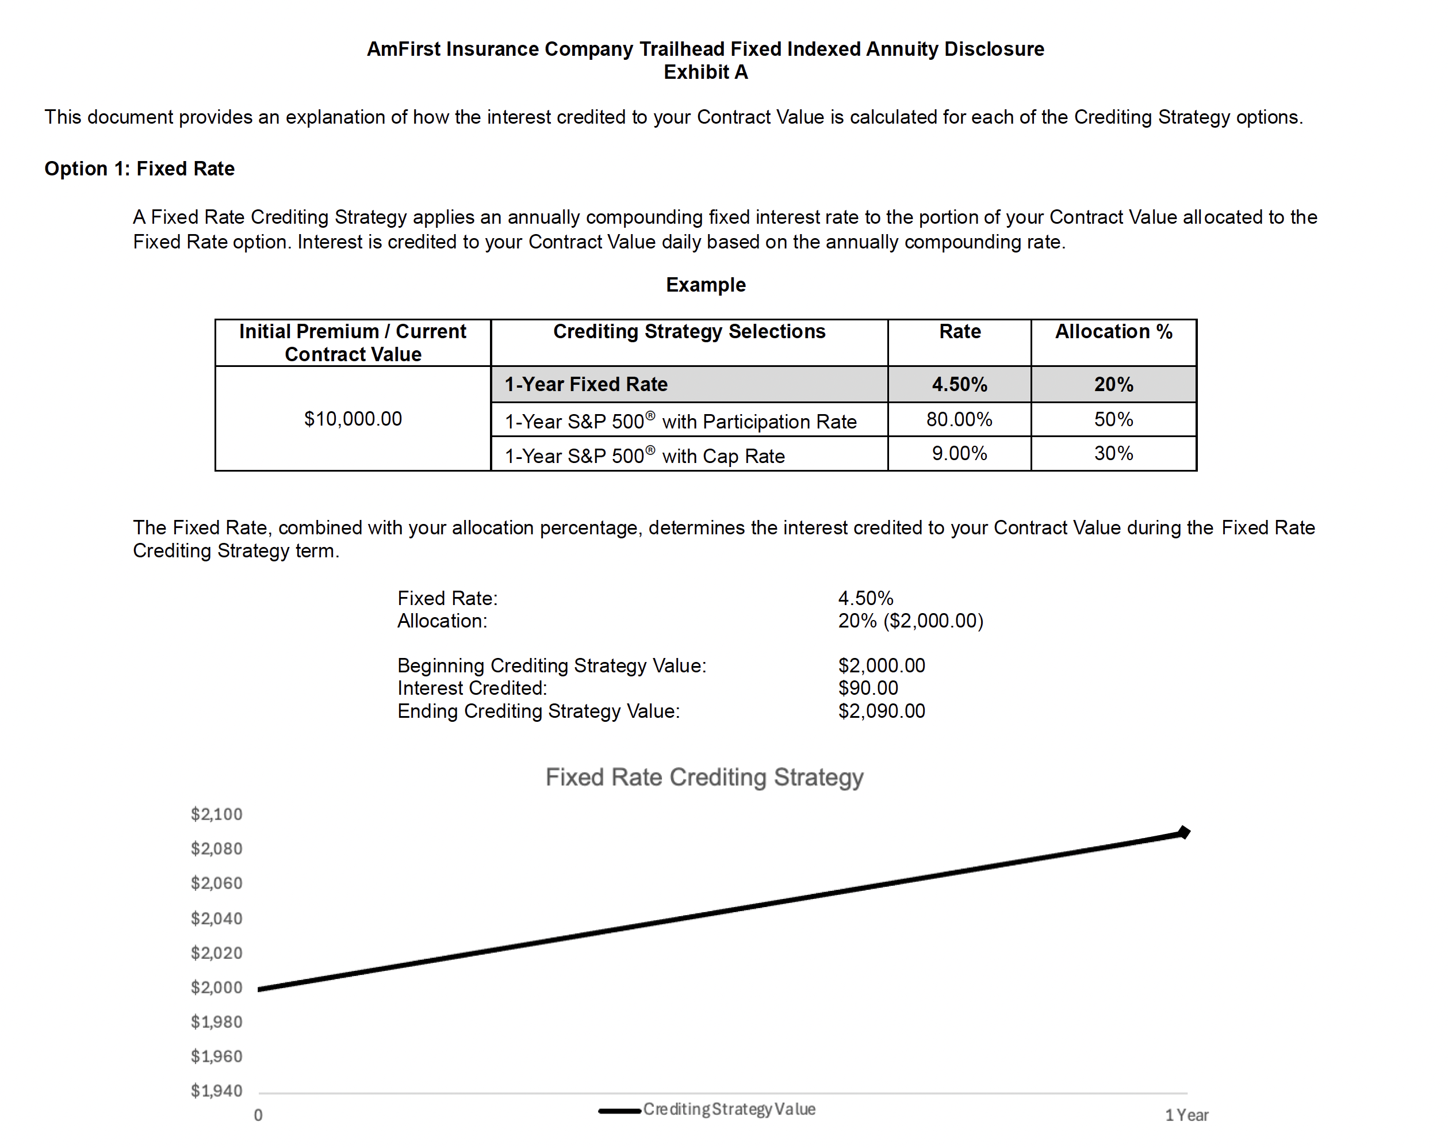
Trailhead FIA / Trailhead FIA PLUS
Product Training
AXI-09-006
1225-0128
Intended for Financial Professionals Only. Not intended for public distribution.

Slide 18
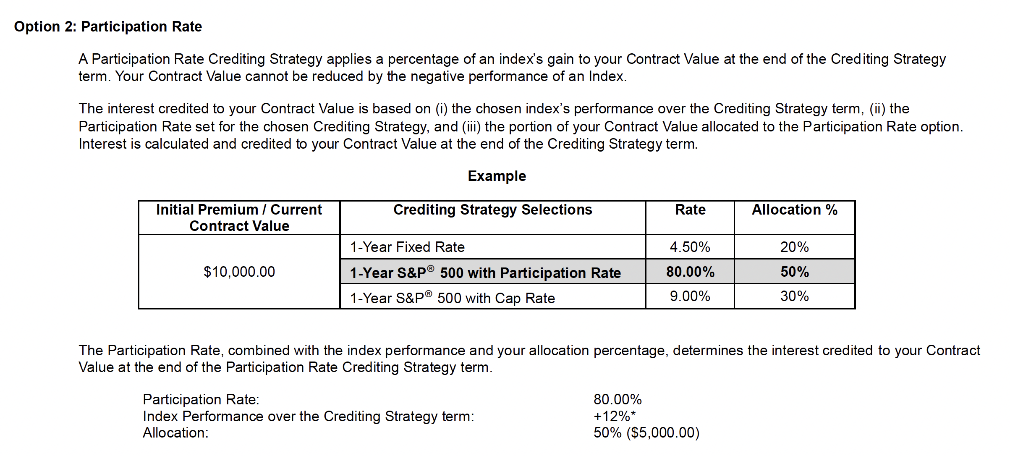
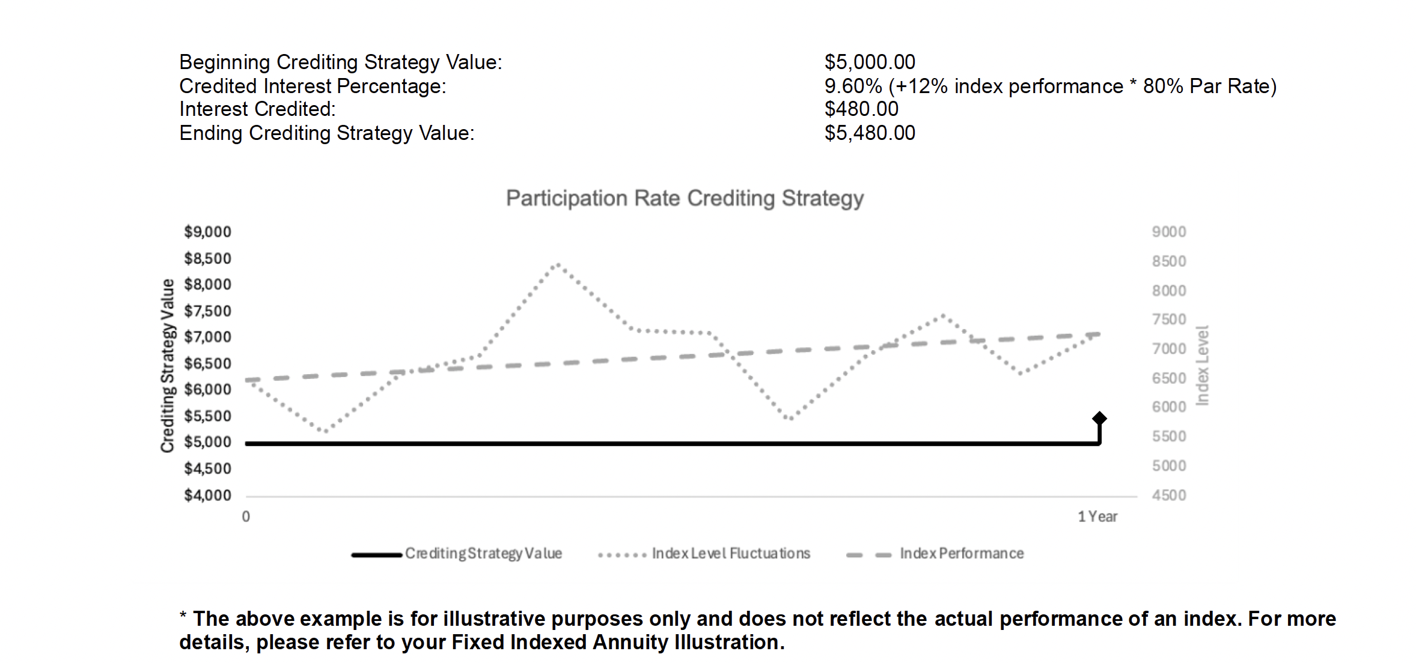
Trailhead FIA / Trailhead FIA PLUS
Product Training
AXI-09-006
1225-0128
Intended for Financial Professionals Only. Not intended for public distribution.

Slide 19
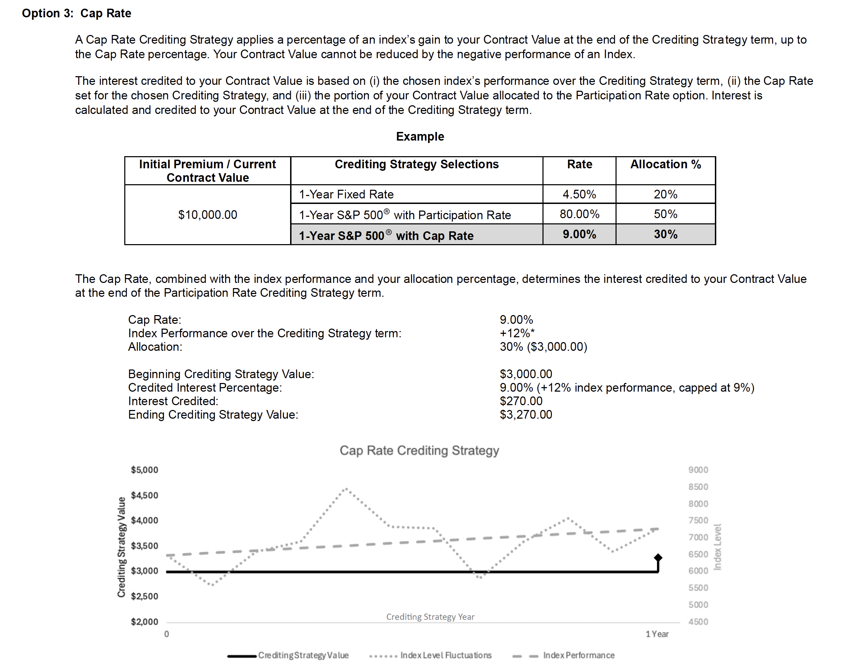
Trailhead FIA / Trailhead FIA PLUS
Product Training
AXI-09-006
1225-0128
Intended for Financial Professionals Only. Not intended for public distribution.

Slide 20
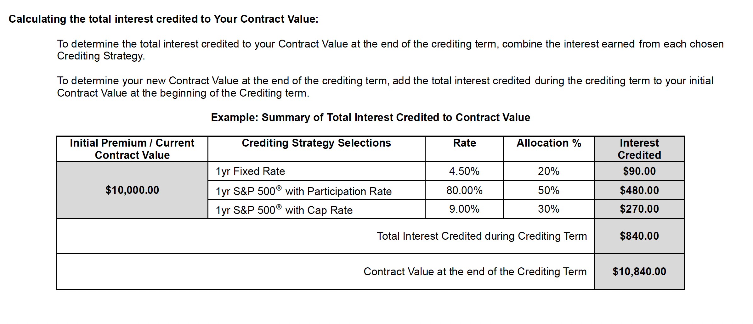
Trailhead FIA / Trailhead FIA PLUS
Product Training
AXI-09-006
1225-0128
Intended for Financial Professionals Only. Not intended for public distribution.

Slide 21
Trailhead FIA / Trailhead FIA PLUS
Product Training
Disclosures
This document provides a brief summary of product features. The contract associated with the product will contain the actual terms, definitions, limitations, and exclusions that apply. Products and services may not be available in all states.
The examples provided are hypothetical and for illustrative purposes only. They do not represent, and should not be interpreted as, predictions or guarantees of any policy’s past or future performance.
Interest credited under indexed interest options may be affected by participation rates, caps, fixed rates, spreads, and/or performance trigger rates. These rates are subject to change at the discretion of the insurer.
Axonic Insurance refers to a group of affiliated legal entities organized under Axonic Insurance Holdings Inc. of Delaware that collectively specialize in designing, distributing, and servicing annuity and other investment products for individuals and institutions worldwide. Axonic Insurance Services LLC (“Axonic”), an insurance producer licensed in all fifty states and the District of Columbia, acts as a business process outsourcer, including for the US-issued annuities underwritten by the non-affiliated AmFirst Life Insurance Company, an Oklahoma domiciled life insurance company (“AmFirst”). AmFirst Insurance Company operates as AmFirst Life Insurance Company in California. Axonic Services LLC, a Puerto Rico limited liability company for profit, services the non US-issued annuities underwritten by its affiliated underwriter, Axonic Insurance Company SPC, a Class B(iii) insurer in the Cayman Islands licensed under the Cayman Islands Insurance Act, 2010 (as amended), as well as the non-affiliated AmFirst Life Insurance Company I.I., a corporation licensed as a Class 5 International Insurer and Segregated Assets Plan Company under Chapter 61 of the Insurance Code of Puerto Rico (“ALIC”). Axonic has ownership interests in segregated accounts of ALIC, which provide reinsurance coverage to AmFirst and other third-party insurers. Axonic Annuity and Life Insurance Company, a Texas domiciled life insurance company is an affiliate of Axonic.
AXI-09-006
1225-0128
Intended for Financial Professionals Only. Not intended for public distribution.

Slide 22
Trailhead FIA / Trailhead FIA PLUS
Product Training
Disclosures (Continued)
S&P 500®
S&P 500 Dynamic Intraday TCA®
The S&P 500® and S&P 500 Dynamic Intraday TCA Index are products of S&P Dow Jones Indices LLC or its affiliates (“SPDJI”) and have been licensed
for use by Axonic Insurance Services LLC. S&P®, S&P 500®, US 500, The 500, iBoxx®, iTraxx® and CDX® are trademarks of S&P Global, Inc. or its
affiliates (“S&P”); Dow Jones® is a registered trademark of Dow Jones Trademark Holdings LLC (“Dow Jones”). Axonic Insurance Service’s LLC
products are not sponsored, endorsed, sold or promoted by SPDJI, Dow Jones, S&P, their respective affiliates and none of such parties make any
representation regarding the advisability of investing in such product(s) nor do they have any liability for any errors, omissions, or interruptions of the
S&P 500® and S&P 500 Dynamic Intraday TCA Index.
AXI-09-006
1225-0128
Intended for Financial Professionals Only. Not intended for public distribution.

Slide 23
Trailhead FIA / Trailhead FIA PLUS
Product Training
Disclosures (Continued)
Nasdaq-100 Volatility Control 7%™
The Product(s) is not sponsored, endorsed, sold or promoted by Nasdaq, Inc., its licensors or Nasdaq or its licensors affiliates (Nasdaq, its licensors with their affiliates, are referred to as the “Corporations”). The Corporations have not passed on the legality or suitability of, or the accuracy or adequacy of descriptions and disclosures relating to, the Product(s). The Corporations make no representation or warranty, express or implied to the owners of the Product(s) or any member of the public regarding the advisability of investing in securities generally or in the Product(s) particularly, or the ability of the Nasdaq-100 Volatility Control 7%™ Index to track general stock market performance. The Corporations' only relationship to Axonic Insurance Services (“Licensee”) is in the licensing of the Nasdaq®, Nasdaq-100 Volatility Control 7%™; XNDX7E™; Nasdaq-100® and certain trade names of the Corporations and the use of the Nasdaq-100 Volatility Control 7%™ Index which is determined, composed and calculated by Nasdaq without regard to Licensee or the Product(s). Nasdaq has no obligation to take the needs of the Licensee or the owners of the Product(s) into consideration in determining, composing or calculating the Nasdaq-100 Volatility Control 7%™ Index . The Corporations are not responsible for and have not participated in the determination of the timing of, prices at, or quantities of the Product(s) to be issued or in the determination or calculation of the equation by which the Product(s) is to be converted into cash. The Corporations have no liability in connection with the administration, marketing or trading of the Product(s). THE CORPORATIONS DO NOT GUARANTEE THE ACCURACY AND/OR UNINTERRUPTED CALCULATION OF THE Nasdaq-100 Volatility Control 7%™ Index OR ANY DATA INCLUDED THEREIN. THE CORPORATIONS MAKE NO WARRANTY, EXPRESS OR IMPLIED, AS TO RESULTS TO BE OBTAINED BY LICENSEE, OWNERS OF THE PRODUCT(S), OR ANY OTHER PERSON OR ENTITY FROM THE USE OF THE Nasdaq-100 Volatility Control 7%™ Index OR ANY DATA INCLUDED THEREIN. THE CORPORATIONS MAKE NO EXPRESS OR IMPLIED WARRANTIES, AND EXPRESSLY DISCLAIM ALL WARRANTIES OF MERCHANTABILITY OR FITNESS FOR A PARTICULAR PURPOSE OR USE WITH RESPECT TO THE Nasdaq-100 Volatility Control 7%™ Index OR ANY DATA INCLUDED THEREIN. WITHOUT LIMITING ANY OF THE FOREGOING, IN NO EVENT SHALL THE CORPORATIONS HAVE ANY
LIABILITY FOR ANY LOST PROFITS OR SPECIAL, INCIDENTAL, PUNITIVE, INDIRECT, OR CONSEQUENTIAL DAMAGES, EVEN IF NOTIFIED OF THE
POSSIBILITY OF SUCH DAMAGES.
AXI-09-006
1225-0128
Intended for Financial Professionals Only. Not intended for public distribution.

Slide 24
Trailhead FIA / Trailhead FIA PLUS
Product Training
Disclosures (Continued)
DB Foresight X-Asset 10 Index
The Trailhead Fixed Indexed Annuity (FIA) (the “Product”) is not sponsored, endorsed, sold or promoted by Deutsche Bank AG or any subsidiary or affiliate of Deutsche Bank AG, Deutsche Bank AG, London Branch or any platform operated by Deutsche Bank AG or any subsidiary or affiliate of Deutsche Bank AG. The DB Foresight X-Asset 10 Index (the “DB Index”) is the exclusive property of Deutsche Bank AG. “Deutsche Bank” and “Deutsche Bank AG”, “Deutsche Bank Global Markets”, “DB Investment Solutions” and “Deutsche Bank AG, London Branch” and “DB Foresight X-Asset 10 IndexTM” are service marks of Deutsche Bank AG; "QuantumStreet AI" is a service mark of EquBot Inc. DBA QuantumStreet AI, and have been licensed for use for certain purposes by Axonic Insurance Services LLC_._ Neither Deutsche Bank AG, Deutsche Bank AG, London Branch, any affiliate of Deutsche Bank AG nor any other party involved in, or related to, making or compiling the DB Index (each a “DB Group Company”) makes any = representation or warranty, express or implied, concerning the DB Index, the Product, the advisability of investing in the Product or in securities generally or as to the results obtained from the use of the DB Index. Other than to the extent required under any applicable law, regulation, principles or guidance, no DB Group Company has any obligation to take the needs of Axonic Insurance Services LLC, the sponsor of the Product, its clients, any distributor of the Product or any holder of the Product into consideration in determining, composing or calculating the DB Index. Neither Deutsche Bank AG, Deutsche Bank AG, London Branch nor any platform operated by Deutsche Bank AG or any subsidiary or affiliate of Deutsche Bank AG sells, solicits, negotiates or effects, and does not aid any other person or entity in selling, soliciting, negotiating or effecting, the Product or any other insurance policy or annuity contract. No member of the DB Group is under any obligation to initiate or continue the calculation, publication and dissemination of the DB Index No DB Group Company is responsible for or has participated in the determination of the timing of, prices at, quantities or valuation of the Product. No DB Group Company has any obligation or liability in connection with the issuance, distribution, administration, marketing or trading of the Product or use of the DB Index in relation to the Products. In addition, no DB Group Company has independently verified the information contained herein. No DB Group Company is responsible for the issue or content included in this Product Disclosure Statement. Accordingly, no representation, warranty or undertaking, express or implied, is made and no responsibility or liability is accepted by such entity as to the accuracy or completeness of the information contained herein.
AXI-09-006
1225-0128
Intended for Financial Professionals Only. Not intended for public distribution.

Slide 25
Trailhead FIA / Trailhead FIA PLUS
Product Training
Disclosures (Continued)
DB Foresight X-Asset 10 Index (Continued)
ALTHOUGH DEUTSCHE BANK AG WILL OBTAIN INFORMATION FOR INCLUSION IN OR FOR USE IN THE CALCULATION OF THE DB INDEX FROM SOURCES WHICH IT CONSIDERS RELIABLE, NO DB GROUP COMPANY WILL INDEPENDENTLY VERIFY SUCH INFORMATION. NO DB GROUP COMPANYWARRANTS OR GUARANTEES THE ACCURACY AND/OR THE COMPLETENESS OF THE DB INDEX OR THE PRODUCT OR ANY DATA INCLUDED THEREIN AND SHALL HAVE NO LIABILITY FOR ANY ERRORS, OMISSIONS, OR INTERRUPTIONS THEREIN AND IS UNDER NO OBLIGATION TO ADVISE ANY PERSON OF ANY ERRORS, OMISSIONS OR INTERRUPTIONS. NO DB GROUP COMPANY MAKES ANY WARRANTY, EXPRESS OR IMPLIED, AS TO RESULTS OR RETURNS TO BE OBTAINED BY INSERT NAME OF LICENSEE] FROM THE USE OF THE DB INDEX OR ANY DATA INCLUDED THEREIN OR FROM INVESTING IN THE PRODUCT. NO DB GROUP COMPANY MAKES ANY EXPRESS OR IMPLIED WARRANTIES, AND EXPRESSLY DISCLAIMS ALL WARRANTIES, OF MERCHANTABILITY OR FITNESS FOR A PARTICULAR PURPOSE OR USE WITH RESPECT TO THE DB INDEX OR ANY DATA INCLUDED THEREIN OR IN THE PRODUCT. WITHOUT LIMITING ANY OF THE FOREGOING, IN NO EVENT SHALL A DB GROUP COMPANY HAVE ANY LIABILITY (WHETHER IN NEGLIGENCE OR OTHERWISE) FOR DIRECT, INDIRECT, PUNITIVE, SPECIAL, CONSEQUENTIAL OR ANY OTHER DAMAGES OR LOSSES (INCLUDING LOST PROFITS) IN CONNECTION WITH THE DB INDEX OR THE PRODUCT, EVEN IF NOTIFIED OF THE POSSIBILITY THEREOF.
DB is acting solely as licensor of the DB Index and that neither DB nor any DB Group Company is acting as an investment advisor or broker-dealer in connection with providing the DB Index, and that no inclusion (or removal) of a security or other asset in the DB Index constitutes a recommendation to buy, sell or hold such security or asset, nor does it constitute investment advice. Axonic Insurance Services LLC has made its own independent decision to use the DB Index (based on its own judgement or the advice of its advisers), is not relying on any communication or other advice from any DB Group Company in connection with the use of the DB Index and understands and is capable of assuming the risks of using the DB Index. The returns of the DB Index do not represent the results of actual trading of the investible assets or securities underlying the DB Index. Deutsche Bank Index Quant, an independent research unit of DB (“DBIQ”), maintains and calculates the DB Index, but does not manage actual assets that notionally comprise the DB Index. The calculation of the DB Index and DB Index returns may deviate from the stated methodology.
AXI-09-006
1225-0128
Intended for Financial Professionals Only. Not intended for public distribution.

Slide 26
Trailhead FIA / Trailhead FIA PLUS
Product Training
Disclosures (Continued)
DB Foresight X-Asset 10 Index (Continued)
DB Index returns do not reflect payment of any sales charges, fees or taxes an investor using the index may be required to pay to purchase or sell the assets notionally underlying the index if such licensee were to directly hold such assets. The imposition of these fees, charges or taxes may cause the performance of a basket of the underlying assets to be different than the performance of the DB Index for Axonic Insurance Services LLC and investors. Past performance of the DB Index is not an indication or guarantee of future results of the DB Index. Where specified in the description of DB Index, the rebalancing and/or recomposition of the DB Index is performed by an independent third party index allocator, EquBot Inc. DBA QuantumStreet AI (“Index Allocator”), in accordance with its proprietary strategy. The performance of the DB Index is, therefore, reliant upon the allocation of the DB Index by the Index Allocator. Axonic Insurance Services LLC and investors in the Products should make their own decision as to the effect of the initial composition and the possible effect of any future rebalancing and/or reconstitution of the DB Index by the Index Allocator. Further information about the Index Allocator can be found at https://quantumstreetai.com/ (a third party website). If the appointment of the Index Allocator is terminated, Axonic Insurance Services LLC and the investors in the Products should note that the DB Index will no longer be rebalanced and/or reconstituted, which may adversely affect the Products. The Index Allocator may use artificial intelligence (“AI”) algorithms to determine rebalancing and/or recomposition of the DB Index. AI algorithms can analyse large amounts of traditional and alternative data sources in order to detect patterns and make predictions, which may be difficult to explain. The data on which an algorithm is trained impacts its outputs and may have bias effects. AI algorithms can learn and adapt without human intervention. This means that the outputs of AI algorithms in any given scenario may change over time, and potentially adversely impacting the DB Index. Using AI algorithms to determine allocations may result in lower returns than would otherwise be the case. The Index Allocator uses and relies on proprietary and non-proprietary AI algorithms, tools and processes. In the event that the Index Allocator is unable to renew any relevant licences or changes third party vendors, this may materially affect the determination of allocations and the performance of the DB Index.
AXI-09-006
1225-0128
Intended for Financial Professionals Only. Not intended for public distribution.

Slide 27
Trailhead FIA / Trailhead FIA PLUS
Product Training
Disclosures (Continued)
DB Foresight X-Asset 10 Index (Continued)
NO ASSURANCE CAN BE GIVEN THAT THE INDEX ALLOCATOR WILL, IN PRACTICE, FOLLOW ITS STRATEGY, NOR THAT ANY SUCH STRATEGY WILL BE PROFITABLE. A STRATEGY MAY BE BASED TO SOME EXTENT ON PREVIOUS TRENDS IN THE MARKETS, BUT THERE IS NO GUARANTEE THAT SUCH TRENDS WILL BE REPEATED IN THE FUTURE. DEUTSCHE BANK AG DOES NOT AUTHORISE, ENDORSE, RATIFY OR OTHERWISE RECOMMEND THE INDEX ALLOCATOR OR THE STRATEGY OR THE SELECTIONS OF PARAMETERS BY SUCH INDEX ALLOCATOR AND ACCEPTS NO LIABILITY OR RESPONSIBILITY WHATSOEVER TO ANY PERSON (INCLUDING ANY FINANCIAL PRODUCT INVESTOR) FOR THE ACTIVITIES PERFORMED BY THE INDEX ALLOCATOR, THE SELECTIONS OF WEIGHTS, THE STRATEGY OR THE RESULTING PERFORMANCE OF THE DB INDEX. DB reserves the right to amend or adjust the methodology for calculating the DB Index from time to time in accordance with the rules governing the calculation of the DB Index and accepts no liability for any such amendment or adjustment. Neither DB or any DB Group Company are under any obligation to continue the calculation, publication or dissemination of the DB Index and accepts no liability for any suspension or interruption in the calculation thereof which is made in accordance with the rules governing the DB Index. No purchaser, seller or holder of the Product, or any other person or entity, should use or refer to any Deutsche Bank trade name, trademark or service mark to sponsor, endorse, market or promote the Product unless this statement is included in any Product Document or Marketing Material in connection therewith. Under no circumstances may any person or entity claim any affiliation with Deutsche Bank without the written permission of DB. Additionally, no content contained in the Marketing Material [(including index data, ratings, credit-related analyses and data, research, valuations, model, software or other application or output therefrom)] or any part thereof (“Content”) may be modified, reverse-engineered, reproduced or distributed in any form or by any means, or stored in a database or retrieval system, without the prior written permission of DB. The Content shall not be used for any unlawful or unauthorized purposes. By using the Product, each Axonic Insurance Services LLC and investor in the Products acknowledges and agrees that neither Deutsche Bank AG, Deutsche Bank AG, London Branch nor any subsidiary or affiliate of Deutsche Bank AG shall have any liability or responsibility to any person or entity for any loss, damages, costs, charges, expenses or other liabilities whether caused by the negligence of Deutsche Bank AG, Deutsche Bank AG, London Branch or any subsidiary or affiliate of Deutsche Bank AG or otherwise, arising in connection with the use of the Product or the DB Index or any Product Document or Marketing Material produced in connection with the Product or the DB Index.
AXI-09-006
1225-0128
Intended for Financial Professionals Only. Not intended for public distribution.

Slide 28
Trailhead FIA / Trailhead FIA PLUS
Product Training
Disclosures (Continued)
DB Foresight X-Asset 10 Index (Continued)
Disclaimer by the Index Allocator
The Index Allocator is acting solely as index allocator in respect of the DB Index and is not acting as an investment adviser or broker-dealer in connection with providing its services. The Product is not sponsored, endorsed, sold or promoted by the Index Allocator. The Index Allocator does not make any representation or warranty, express or implied, concerning the Index, the Product, the advisability of investing in the Product or in securities generally or as to the results obtained from the use of the Index Allocator’s services. The Index Allocator does not take the needs of any person into consideration in providing its services. The Index Allocator does not sell, solicit, negotiate or effect, and does not aid any other person or entity in selling, soliciting, negotiating or effecting, the Product or any other insurance policy or annuity contract. The Index Allocator is not responsible for nor does it participate in the determination of the timing of, prices at, quantities or valuation of the Product. The Index Allocator does not have any obligation or liability in connection with the issuance, distribution, administration, marketing or trading of the Product or use of the DB Index in relation to the Products. In addition, the Index Allocator has not independently verified the information contained herein. The Index Allocator is not responsible for the issuance or content included in this Product Disclosure Statement. Accordingly, no representation, warranty or undertaking, express or implied,
is made and no responsibility or liability is accepted by the Index Allocator as to the accuracy or completeness of the information contained herein.
AXI-09-006
1225-0128
Intended for Financial Professionals Only. Not intended for public distribution.

